Slide 1

SQL Management Studio
Performance Tuning
Metadata Examples
Version 1.0
Shrikesh Pattni

Slide 2
How we should think of Master Metadata Management
Data Warehouse
Volume: SQL Tables, Dev/Test/Production
Volume: 3,000 + data assets in enterprise heavy data projects
Velocity: Data is updated daily/weekly with increments
Variety: Increase in complexity of relationships/data types
Veracity: Daily backups/Version control enables quality
Value: Timestamp data attributes,
Metadata/Governance
Value: Removing confusion by understanding data definitions
Value: Better levels of completeness/accuracy/row count of data
Value: Removing assumptions and guess work on data structure
Value: Better levels of performance optimisations on data assets
Value: Increase confidence to technical/non technical stakeholders
Value : *All above resulting In better communication channels*
Data Warehouse
Data Taxonomy
Variety: Classification of data assets into valuable entities
Value: Data Dictionary enables better levels of insights
Veracity: Increase data trust to increase value and engagement
Veracity: Remove biased and falsification (integer value column)
Metadata/Governance
Value Creation
Value: Richer, tangible value around Data Analytics
Value: Team engagement, active as opposed to reactive culture
Value: Internal/External operational value add changes
Value: Performance Optimisations on data assets
Taxonomy
Value Creation

Slide 3

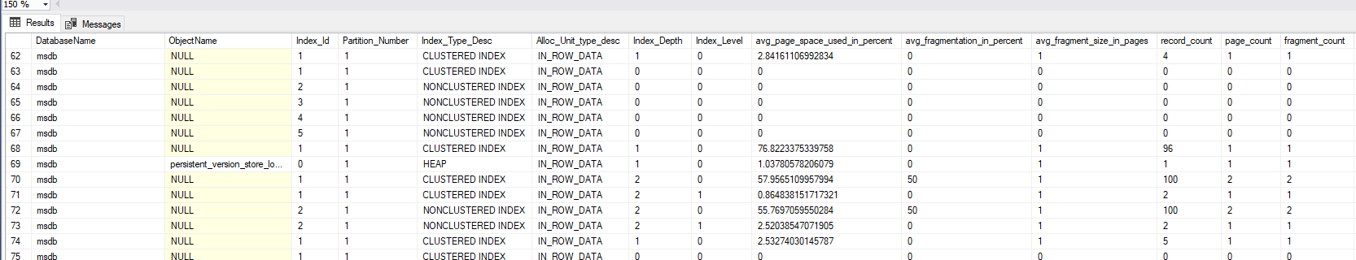
Find Average Space Used Page Count
00
Shrikesh Pattni

Slide 4
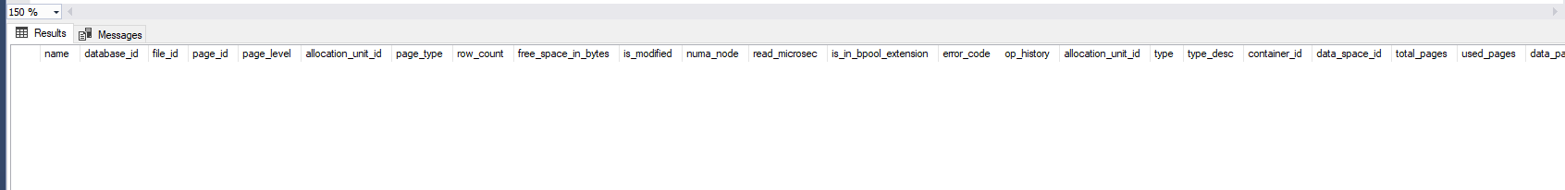
Find Buffer Descriptions
01
Shrikesh Pattni

Slide 5
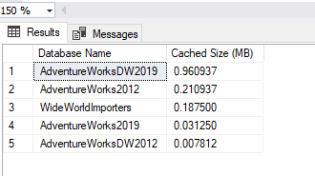
Find Buffer Pool Cache Size
02
Shrikesh Pattni

Slide 6
Find Buffer Pool Cache Size
03
Shrikesh Pattni

Slide 7
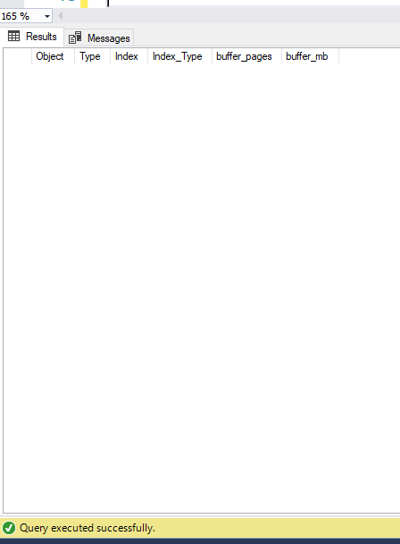
Find Buffer Usage For Each Database
04
Shrikesh Pattni

Slide 8
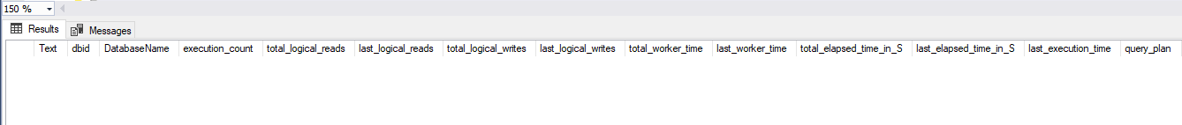
Find the most intensive CPU Queries
05
Shrikesh Pattni

Slide 9
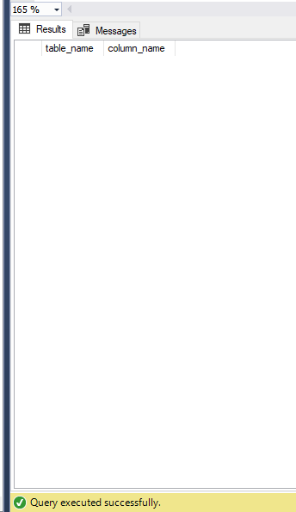
Find Column Exist in Multiple Tables
06
Shrikesh Pattni

Slide 10
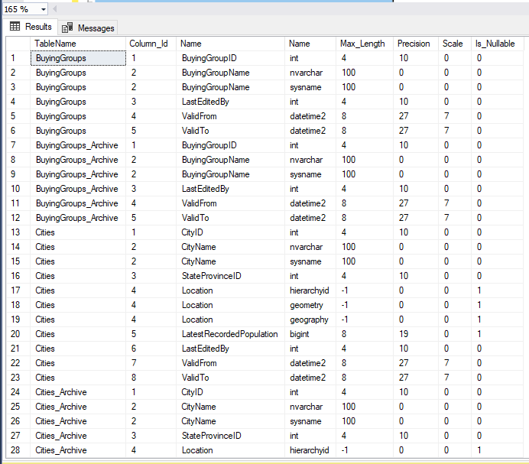
Find column names and data types
07
Shrikesh Pattni

Slide 11
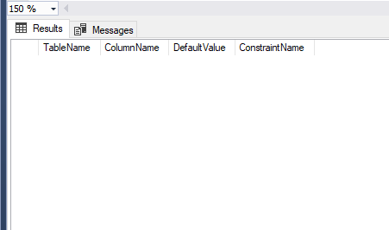
Find columns Names with constraints
08
Shrikesh Pattni

Slide 12
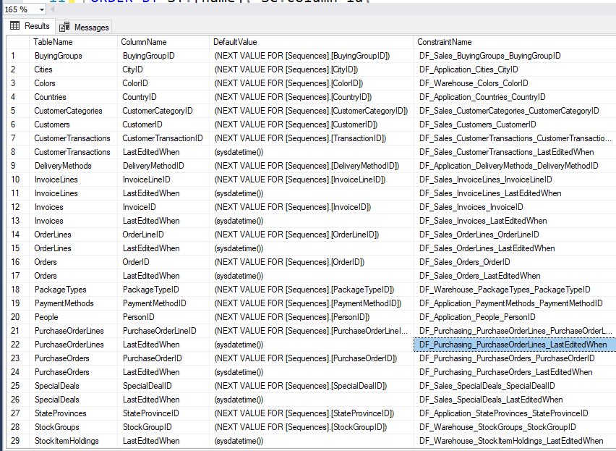
Find Columns With Constraints And Defaults
09
Shrikesh Pattni

Slide 13
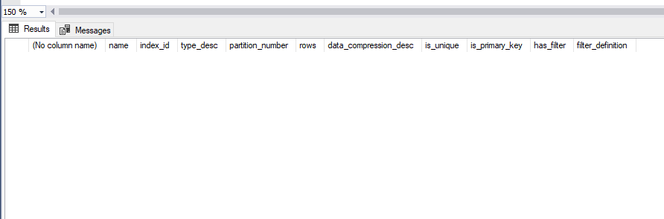
Find Compressed Indexes For The Object
10
Shrikesh Pattni

Slide 14
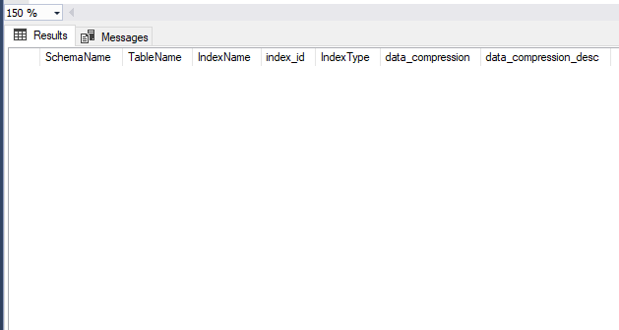
Find Compressed Indexes
11
Shrikesh Pattni

Slide 15
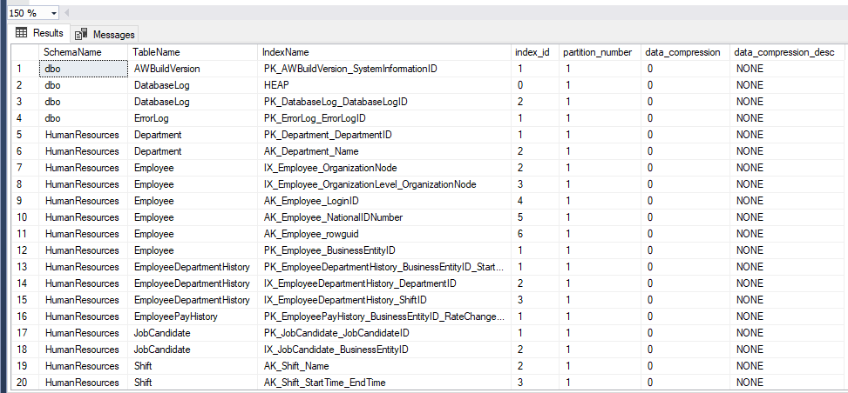
Find Compression Info For All Indexes In A Databases
12
Shrikesh Pattni

Slide 16
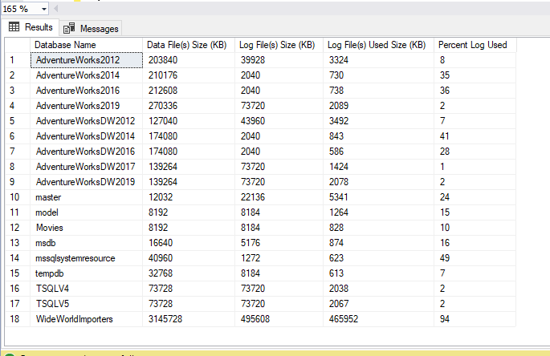
Find Data Size And Log Size And Percent Log
13
Shrikesh Pattni

Slide 17
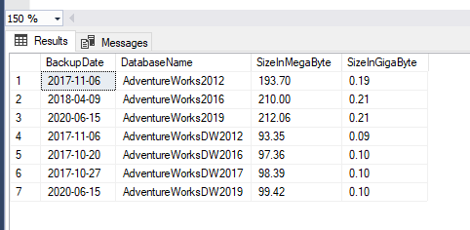
Find Database Backup Size In GB
14
Shrikesh Pattni

Slide 18
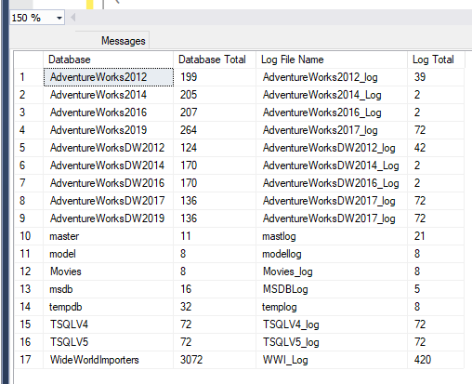
Find Database Data and T-Log Size
15
Shrikesh Pattni

Slide 19
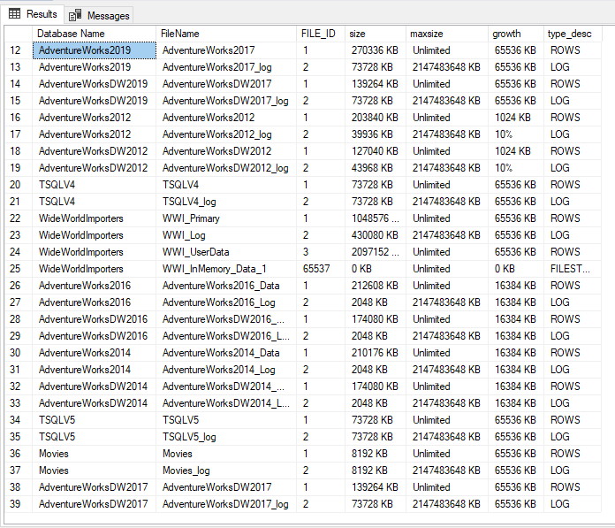
Find Database File Growth Settings
16
Shrikesh Pattni

Slide 20
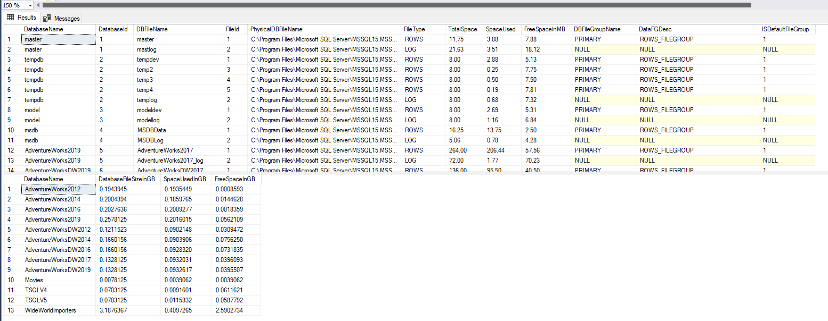
Find Database File space and File Group
17
Shrikesh Pattni

Slide 21
Find Detailed Information on Existing Indexes
18
Shrikesh Pattni

Slide 22
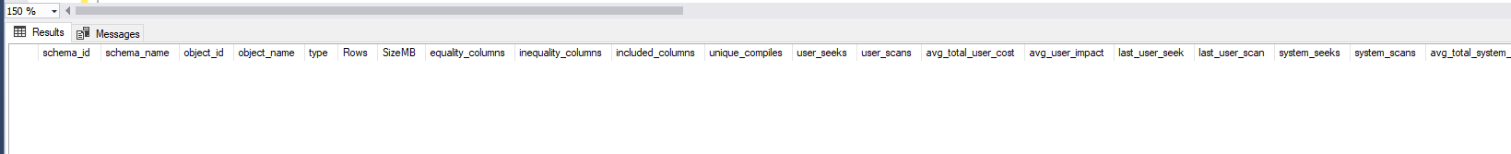
Find Detailed Information on Missing Indexes
19
Shrikesh Pattni

Slide 23
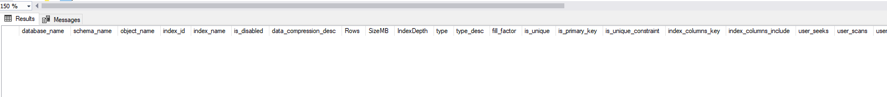
Find Detailed Information on Not Being Seeked Indexes
20
Shrikesh Pattni

Slide 24
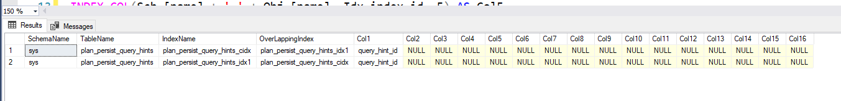
Find Duplicate and Overlapping Indexes
21
Shrikesh Pattni

Slide 25
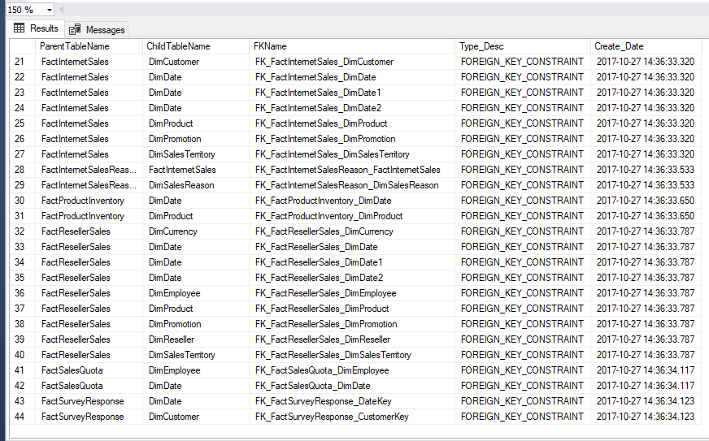
Find FK Constraints. SQL
22
Shrikesh Pattni

Slide 26
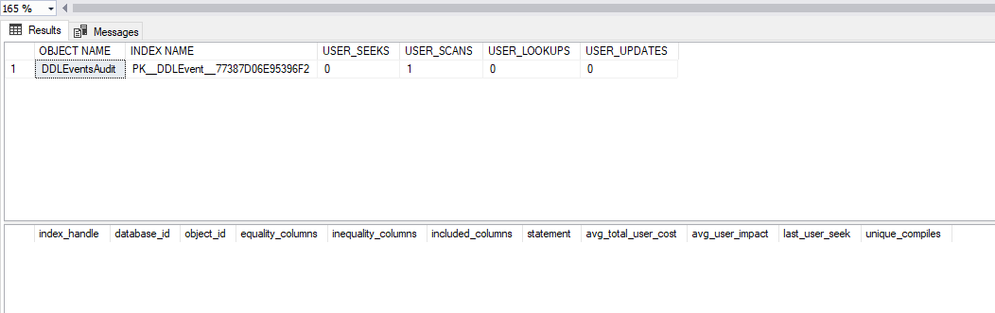
Find Index Usage and Recommended Missing Indexes
22
Shrikesh Pattni

Slide 27
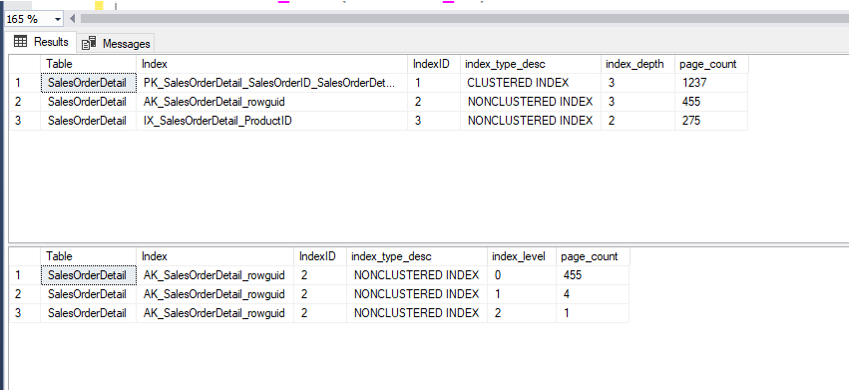
Find Index dept and Page Count for Each Level of index
23
Shrikesh Pattni

Slide 28
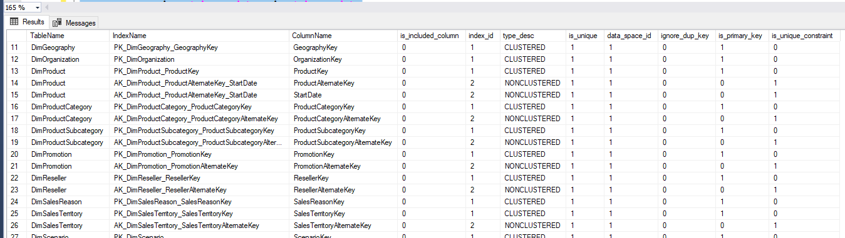
Find Indexed Columns
24
Shrikesh Pattni

Slide 29
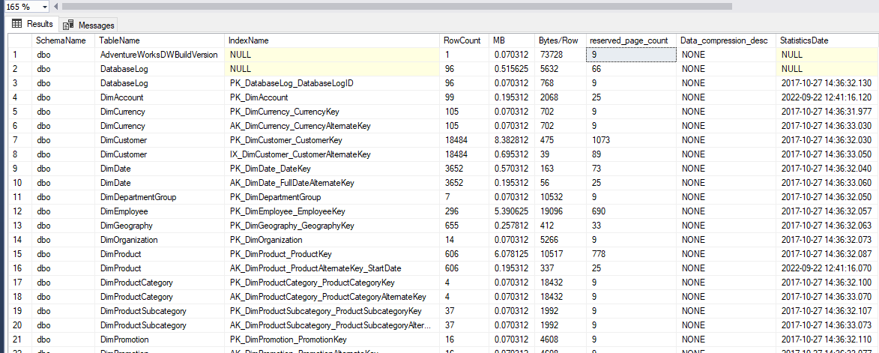
Find Index Size and Stats For All Indexes
25
Shrikesh Pattni

Slide 30
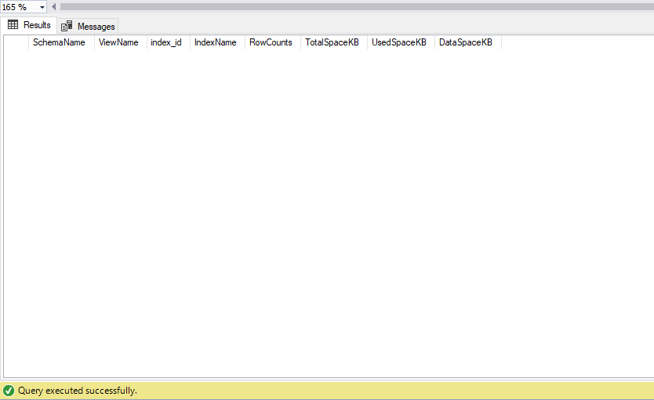
Find Indexed and it’s View Size
26
Shrikesh Pattni

Slide 31
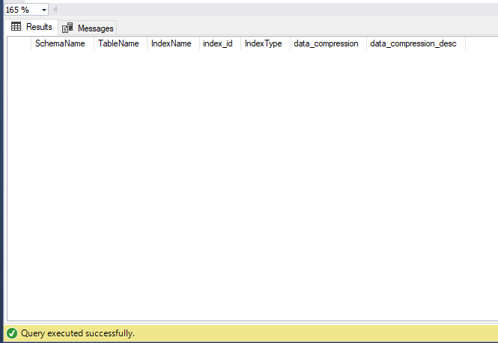
Find Indexes with Most Contention
27
Shrikesh Pattni

Slide 32
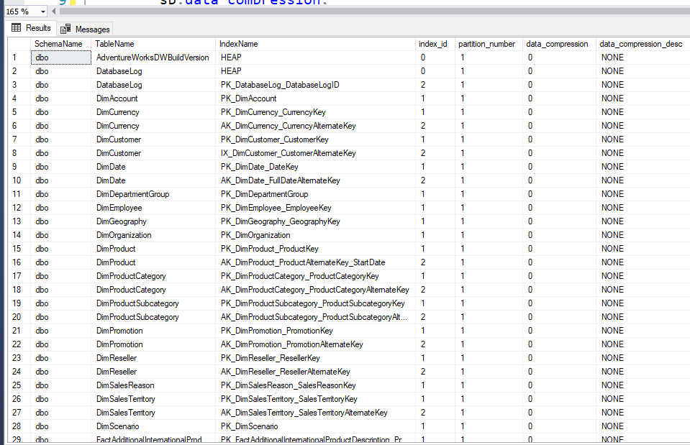
Find Compression Info For All Indexes In A Database
28
Shrikesh Pattni

Slide 33
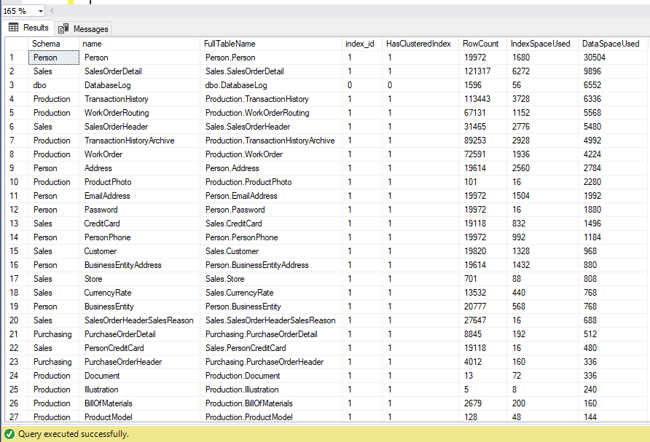
Find Table and Index Space Usage's
29
Shrikesh Pattni

Slide 34
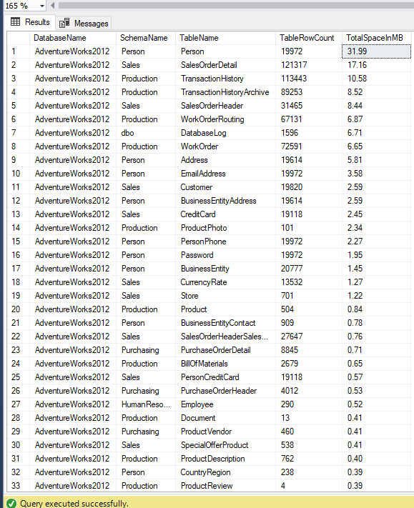
Find Table Size in All Databases
30
Shrikesh Pattni

Slide 35
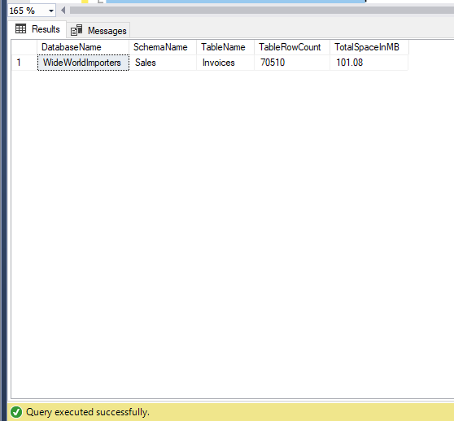
Find Table Sizes MB>100
31
Shrikesh Pattni

Slide 36
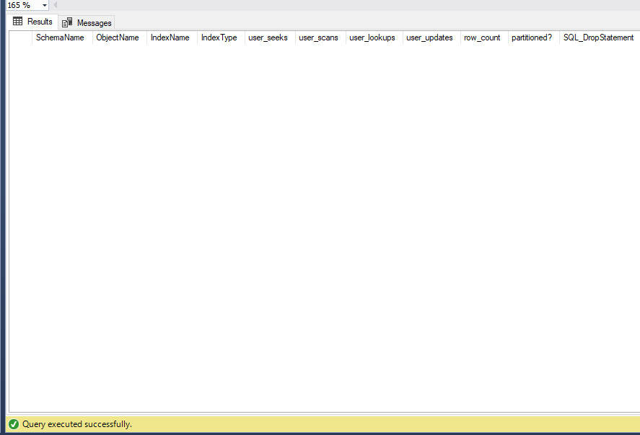
Find Unused Indexes
32
Shrikesh Pattni

Slide 37
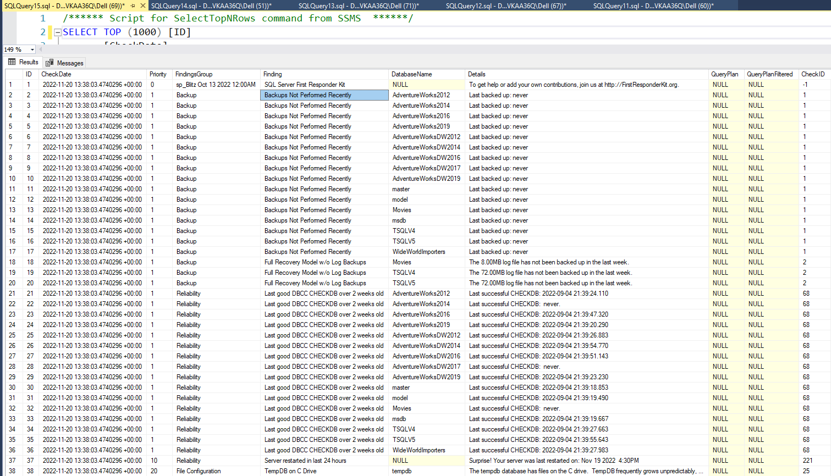
Complete an advanced diagnostics health check on databases
33
Shrikesh Pattni

Slide 38
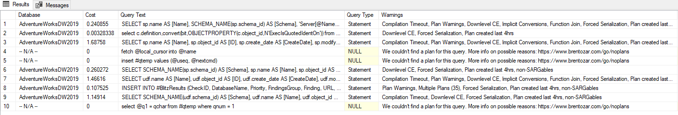
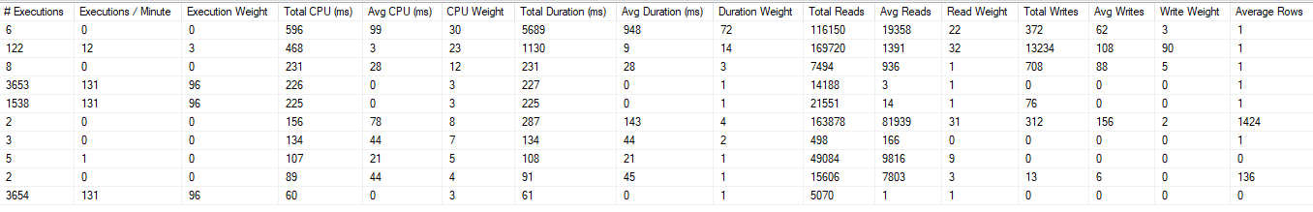
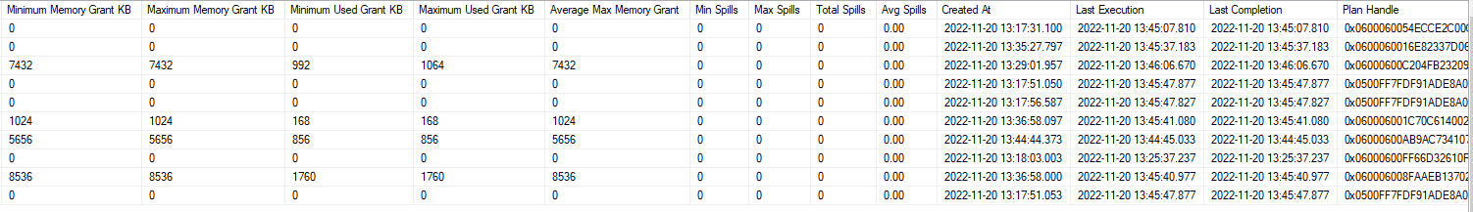
34
Complete an advanced diagnostics health check on Top 10 most intensive queries
Shrikesh Pattni

